Slide 1
Azure Stream Analytics
Dutch Azure Meetup

Slide 2
Stream Analytics
A fully managed, cost effective real-time event processing engine PaaS
Set up real-time analytic computations on data streaming from devices, sensors, web sites, social media, applications, infrastructure systems
Data transformation expressed in a (T-)SQL-like language

Slide 3
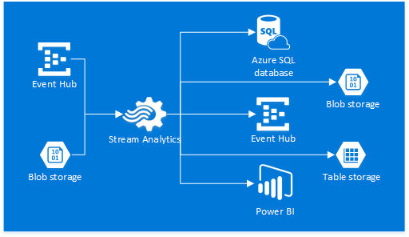

Slide 4
Streaming Units
Streaming units (SUs) represent the resources and computing power required to execute an Azure Stream Analytics
Describe the relative event processing capacity based on a blended measure of CPU, memory, and read and write rates.
Each streaming unit corresponds to roughly 1MB/second of throughput
The valid values start at 1, 3, 6 and then upwards in increments of 6

Slide 5
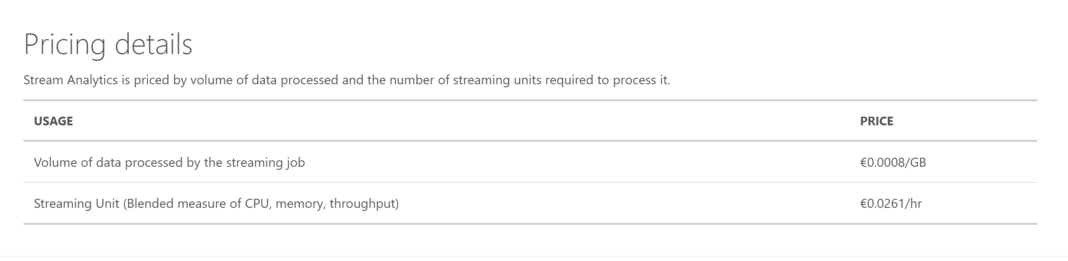
Pricing

Slide 6
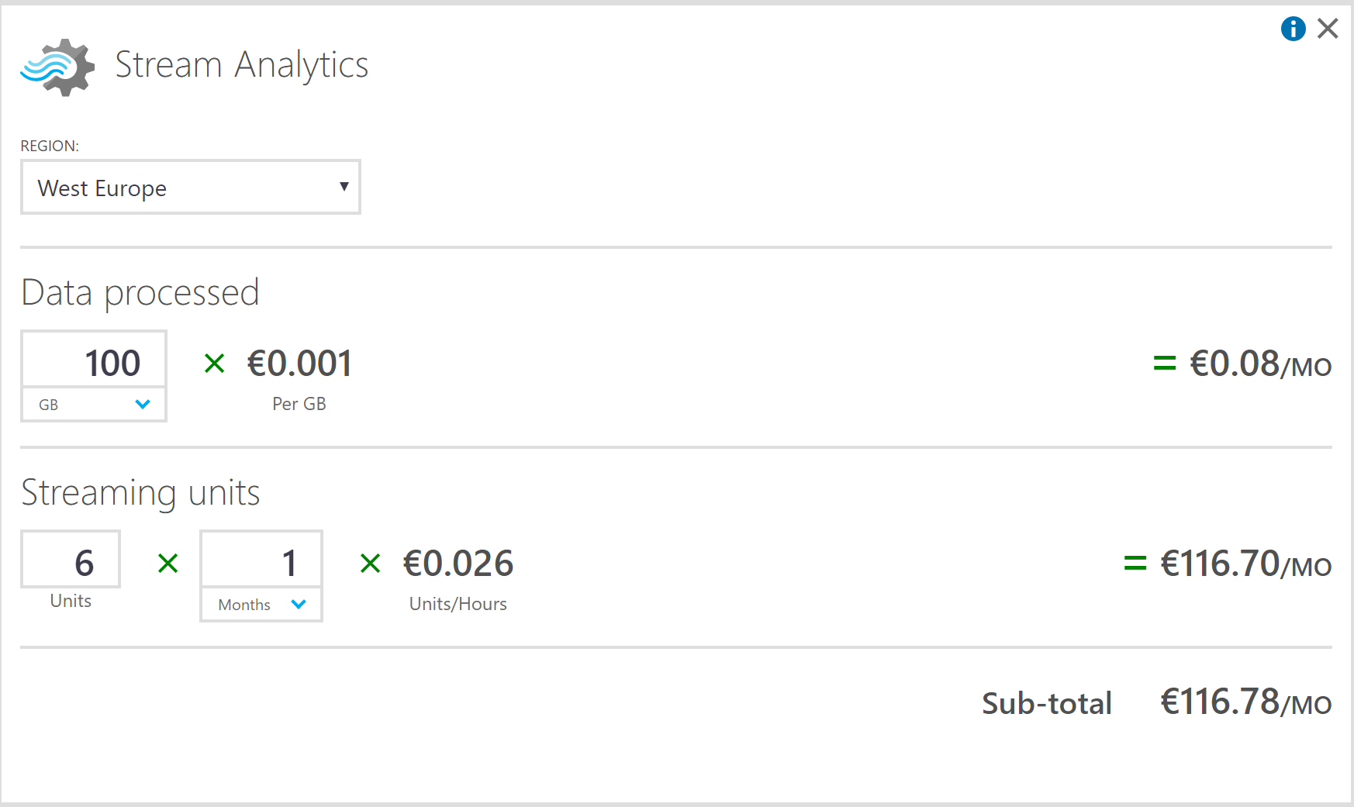

Slide 7
Lab 2
http://xpir.it/azurebd2

